Slide 1
Software Engineering
Sara Rehmat
MS (CS)

Slide 2
Decorator Pattern - Intent
Decorator is a structural design pattern that lets you attach new behaviors to objects by placing these objects inside special wrapper objects that contain the behaviors.

Slide 3
Decorator Pattern - Problem
Imagine that you’re working on a notification library which lets other programs notify their users about important events.
The initial version of the library was based on the Notifier class that had only a few fields, a constructor and a single send method.
The method could accept a message argument from a client and send the message to a list of emails that were passed to the notifier via its constructor.
A third-party app which acted as a client was supposed to create and configure the notifier object once, and then use it each time something important happened.

Slide 4
Decorator Pattern - Problem
In future, some of the users want to be notified on SMS about critical issues. Others would like to be notified on Facebook and, of course, the corporate users would love to get Slack notifications.
You extended the Notifier class and put the additional notification methods into new subclasses. Now the client was supposed to instantiate the desired notification class and use it for all further notifications.

Slide 5
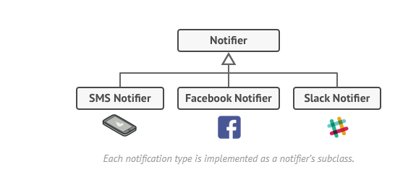

Slide 6
Decorator Pattern - Problem
But then someone reasonably asked you, “Why can’t you use several notification types at once? If your house is on fire, you’d probably want to be informed through every channel.”
You tried to address that problem by creating special subclasses which combined several notification methods within one class.
However, it quickly became apparent that this approach would bloat the code immensely, not only the library code but the client code as well.
You have to find some other way to structure notifications classes so that their number won’t accidentally break some Guinness record.

Slide 7
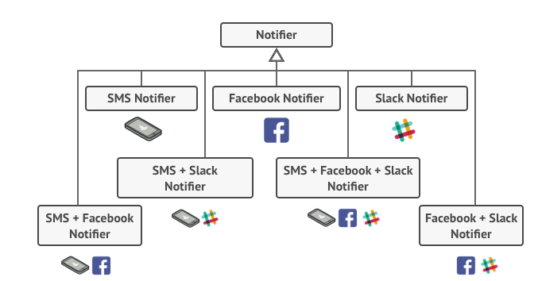

Slide 8
Decorator Pattern – Solution
Extending a class is the first thing that comes to mind when you need to alter an object’s behavior. However, inheritance has several serious caveats that you need to be aware of.
Inheritance is static. You can’t alter the behavior of an existing object at runtime. You can only replace the whole object with another one that’s created from a different subclass.
Subclasses can have just one parent class. In most languages, inheritance doesn’t let a class inherit behaviors of multiple classes at the same time.

Slide 9
Decorator Pattern – Solution
One of the ways to overcome these caveats is by using Aggregation or Composition instead of Inheritance.
Both of the alternatives work almost the same way: one object has a reference to another and delegates it some work, whereas with inheritance, the object itself is able to do that work, inheriting the behavior from its superclass.

Slide 10
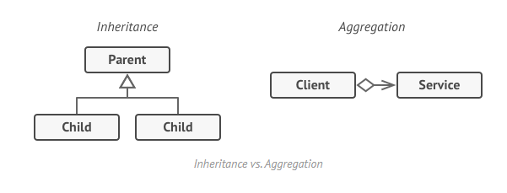

Slide 11
Decorator Pattern - Solution
With this new approach you can easily substitute the linked “helper” object with another, changing the behavior of the container at runtime.
An object can use the behavior of various classes, having references to multiple objects and delegating them all kinds of work.
Aggregation/composition is the key principle behind many design patterns, including Decorator.

Slide 12
Decorator Pattern
Wrapper is the alternative nickname for the Decorator pattern that clearly expresses the main idea of the pattern.
A “wrapper” is an object that can be linked with some “target” object. The wrapper contains the same set of methods as the target and delegates to it all requests it receives.
However, the wrapper may alter the result by doing something either before or after it passes the request to the target.
When does a simple wrapper become the real decorator?
The wrapper implements the same interface as the wrapped object. That’s why from the client’s perspective these objects are identical.
Make the wrapper’s reference field accept any object that follows that interface. This will let you cover an object in multiple wrappers, adding the combined behavior of all the wrappers to it.

Slide 13
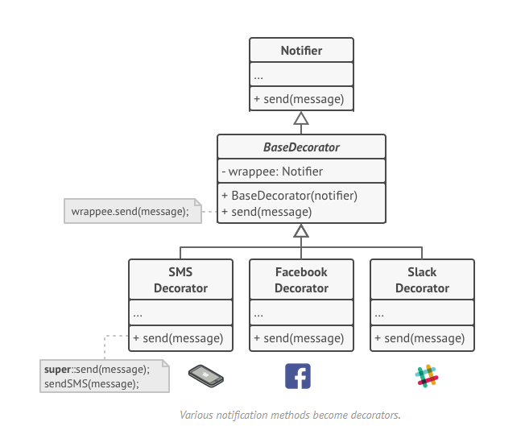

Slide 14
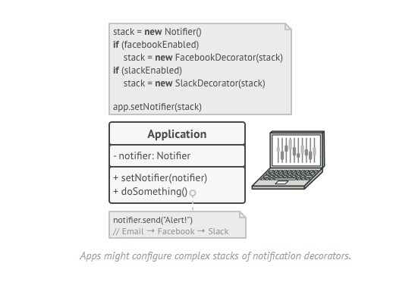

Slide 15
Decorator Pattern - Solution
In our notifications example, let’s leave the simple email notification behavior inside the base Notifier class, but turn all other notification methods into decorators.
The client code would need to wrap a basic notifier object into a set of decorators that match the client’s preferences. The resulting objects will be structured as a stack.
The last decorator in the stack would be the object that the client actually works with. Since all decorators implement the same interface as the base notifier, the rest of the client code won’t care whether it works with the “pure” notifier object or the decorated one.

Slide 16
Real-World Analogy
Wearing clothes is an example of using decorators. When you’re cold, you wrap yourself in a sweater. If you’re still cold with a sweater, you can wear a jacket on top. If it’s raining, you can put on a raincoat. All of these garments “extend” your basic behavior but aren’t part of you, and you can easily take off any piece of clothing whenever you don’t need it.

Slide 17
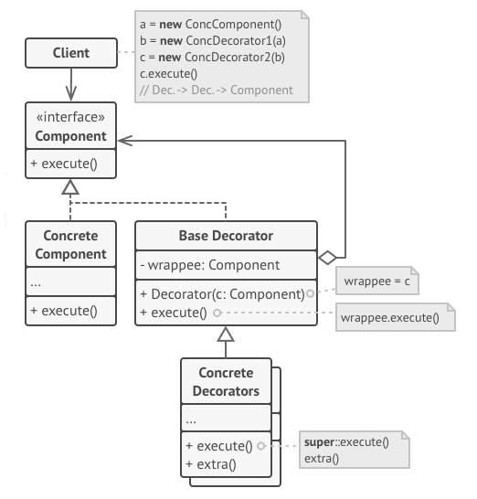
Decorator Pattern - Structure
5. The Client can wrap components in multiple layers of decorators, as long as it works with all objects via the component interface.
3. The Base Decorator class has a field for referencing a wrapped object. The field’s type should be declared as the component interface so it can contain both concrete components and decorators. The base decorator delegates all operations to the wrapped object.
1. The Component declares
the common interface for
both wrappers and wrapped objects.
2. Concrete Component
is a class of objects being wrapped. It defines the basic behavior, which can be altered by decorators.
4. Concrete Decorators define extra behaviors that can be added to components dynamically. Concrete decorators override methods of the base decorator and execute their behavior either before or after calling the parent method.

Slide 18
Decorator Pattern - Pseudocode
In this example, the Decorator pattern lets you compress and encrypt sensitive data independently from the code that actually uses this data.
The application wraps the data source object with a pair of decorators. Both wrappers change the way the data is written to and read from the disk:
Just before the data is written to disk, the decorators encrypt and compress it. The original class writes the encrypted and protected data to the file without knowing about the change.
Right after the data is read from disk, it goes through the same decorators, which decompress and decode it.
The decorators and the data source class implement the same interface, which makes them all interchangeable in the client code.

Slide 19
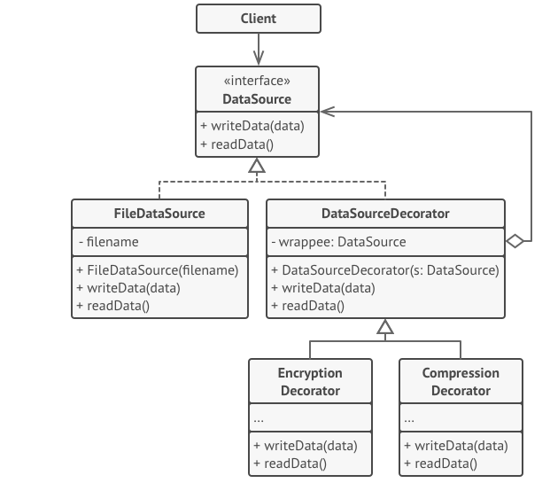
Encryption and Compression Decorators Class

Slide 20
Decorator Pattern - Applicability
Use the Decorator pattern when you need to be able to assign extra behaviors to objects at runtime without breaking the code that uses these objects.
Use the pattern when it’s awkward or not possible to extend an object’s behavior using inheritance.

Slide 21
Decorator Pattern – Implementation Steps
Make sure your business domain can be represented as a primary component with multiple optional layers over it.
Figure out what methods are common to both the primary component and the optional layers. Create a component interface and declare those methods there.
Create a concrete component class and define the base behavior in it.
Create a base decorator class. It should have a field for storing a reference to a wrapped object. The field should be declared with the component interface type to allow linking to concrete components as well as decorators. The base decorator must delegate all work to the wrapped object.
Make sure all classes implement the component interface.
Create concrete decorators by extending them from the base decorator. A concrete decorator must execute its behavior before or after the call to the parent method (which always delegates to the wrapped object).
The client code must be responsible for creating decorators and composing them in the way the client needs.

Slide 22
Decorator Pattern - Pros
You can extend an object’s behavior without making a new subclass.
You can add or remove responsibilities from an object at runtime.
You can combine several behaviors by wrapping an object into multiple decorators.
Single Responsibility Principle. You can divide a monolithic class that implements many possible variants of behavior into several smaller classes.

Slide 23
Decorator Pattern - Cons
It’s hard to remove a specific wrapper from the wrappers stack.
It’s hard to implement a decorator in such a way that its behavior doesn’t depend on the order in the decorators stack.
The initial configuration code of layers might look pretty ugly.

Slide 24
References
https://refactoring.guru/design-patterns

